Slide 1
Book Bazaar
Presented By-
Fairuz Shezuti Rahman
15.01.04.098

Slide 2
Introduction
Book Bazaar is a online web application where the customer can purchase books online. Through a web browser the customers can search for a book by its title or author name. In this era of internet, Book Bazaar is useful for purchasing books without any hazard.

Slide 3
Project Idea
Book Bazaar is a website which have-
Home , Category and Review option in every page.
Category webpage contains many categories of books to find it easily
There is search option where we can also find books by its title or author name.
Every category has different pages.

Slide 4
Tools
Main Languages: HTML, CSS, PHP
Database: MySQL
Cross-Platform: XAMMP

Slide 5
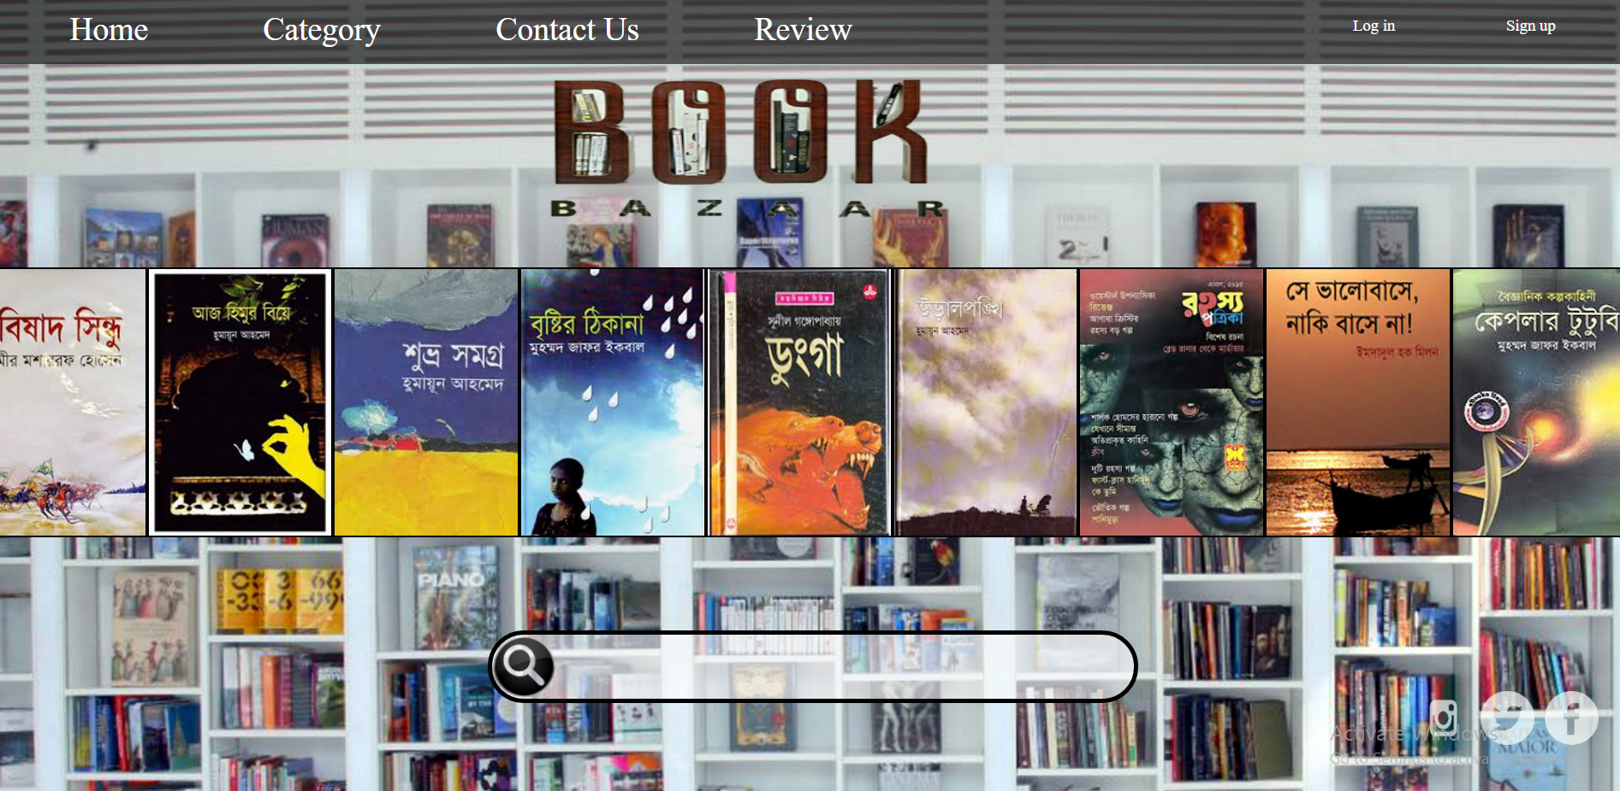
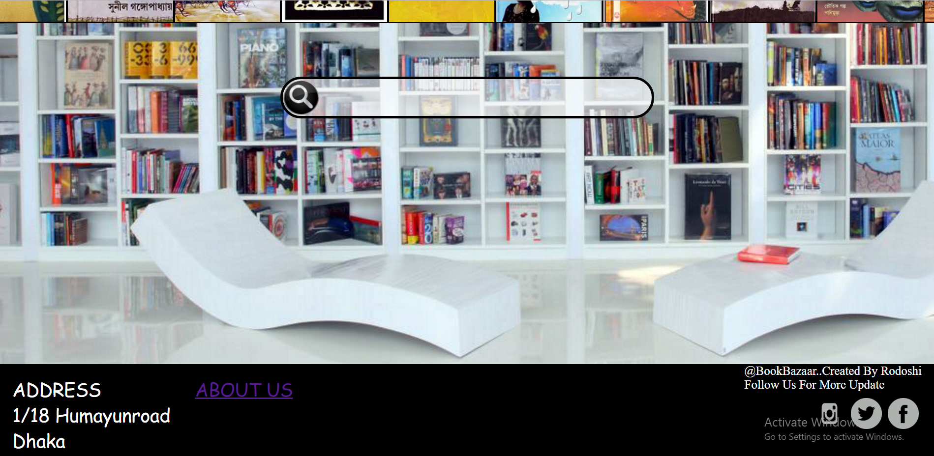
Home Page

Slide 6
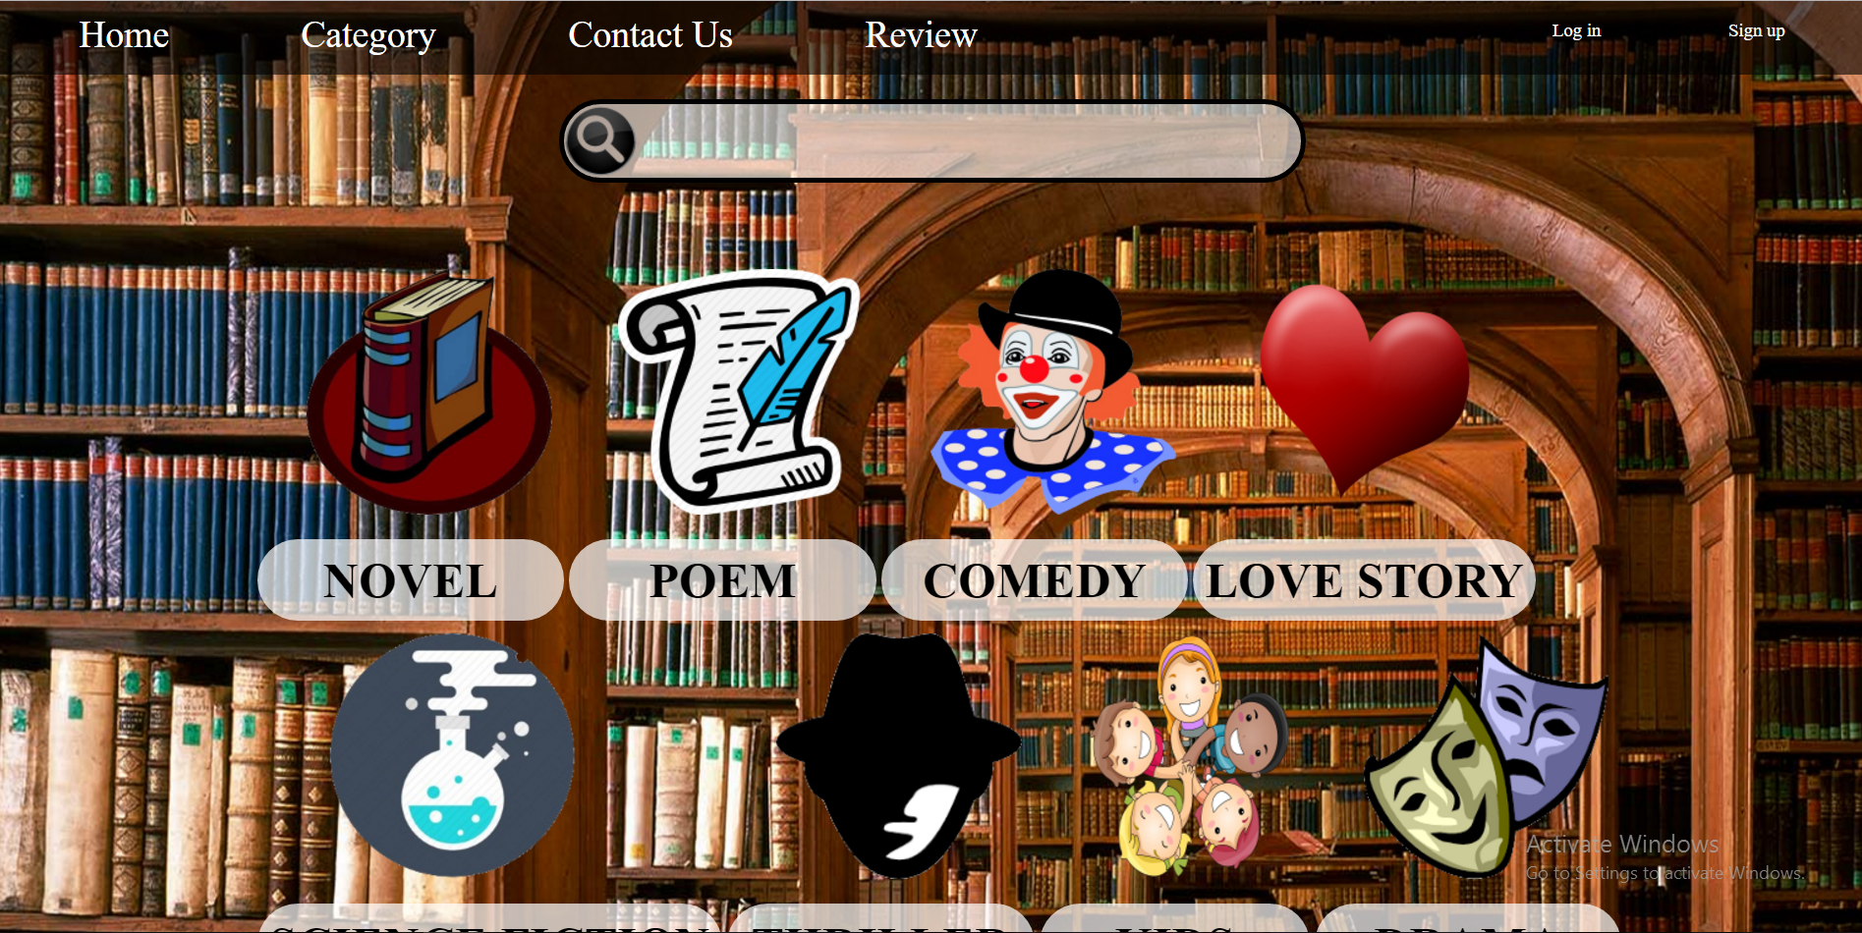

Category Page

Slide 7
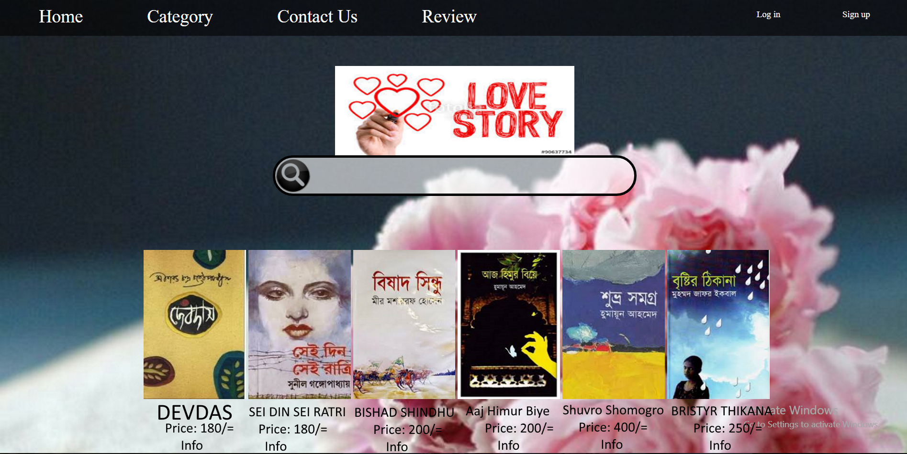
Love Story(Category)

Slide 8

Cart
Book Id | Title | Author | Price | Customer Id
01223 | Aaj Himur Biye | Humayun Ahmend | 200/= | 098
5516 | Gitanjoli | Robindranath Tagor | 300/= | 524
3821 | DEVDAS | Shorot Chandra Chottopodday | 180/= | 524
6482 | MA | Anisur Rahman | 250/= | 326

Slide 9
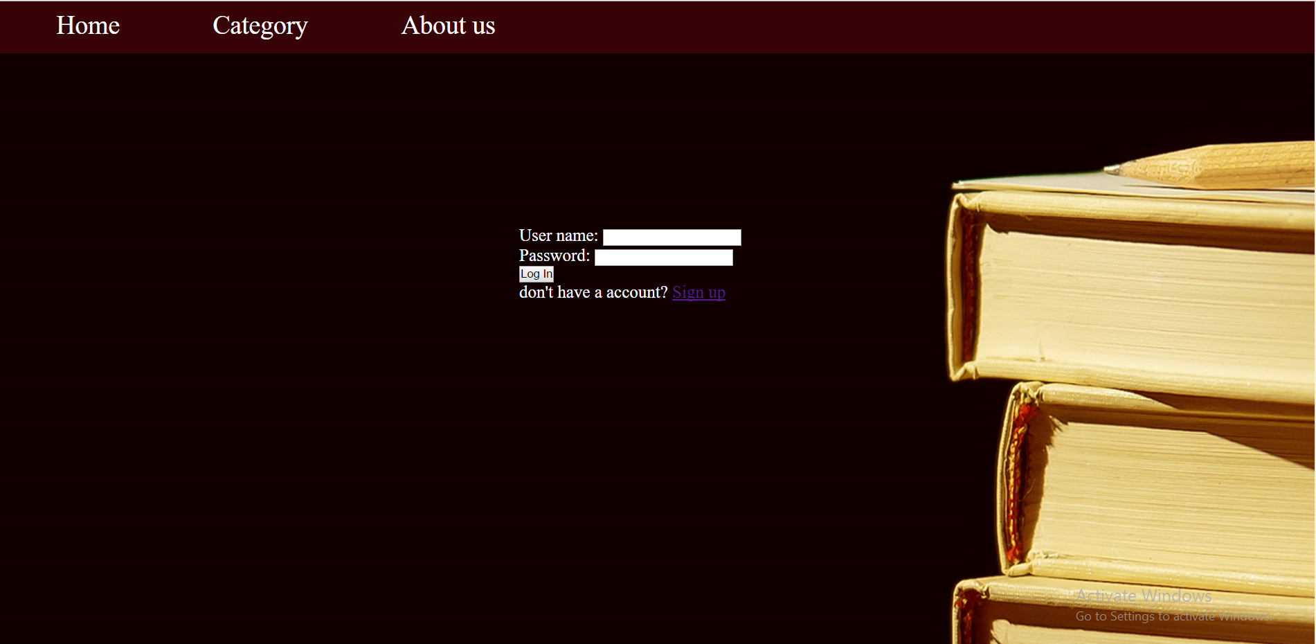
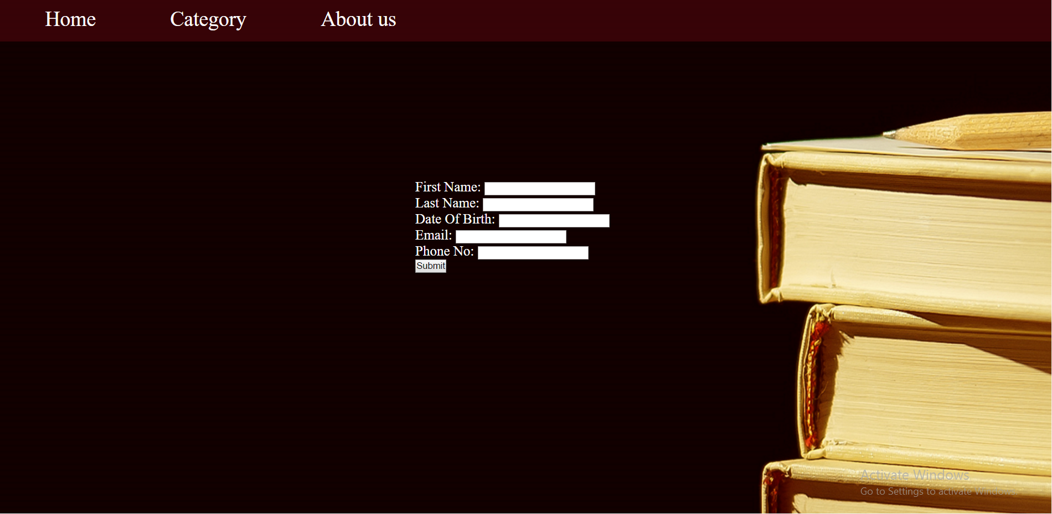
Log In/Sign Up

Slide 10
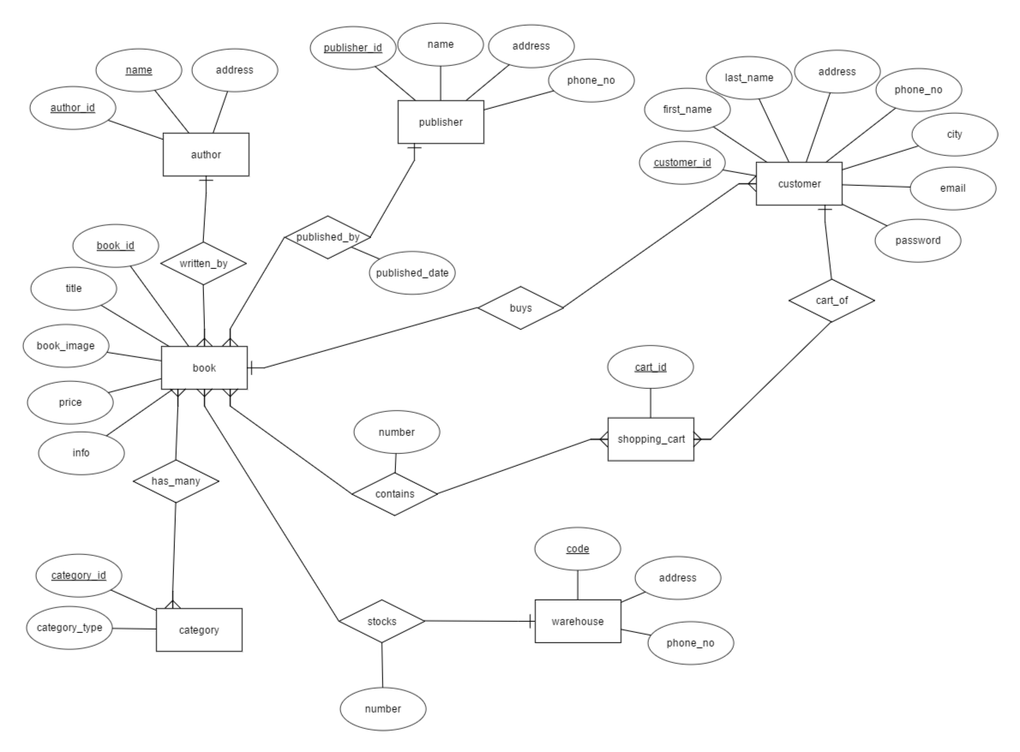
ER Diagram

Slide 11
Future Planning
Online reading facilities
Auto suggest books according to priority

Slide 12
Remarks
In the era of internet online book shop is very much needed as people don’t want to go to shops to buy books. Sometimes it’s difficult for the students of rural area to find books in there place. So they can use the website and find whatever book they want.

Slide 13

Thank You
Happy Reading….

